Slide 1
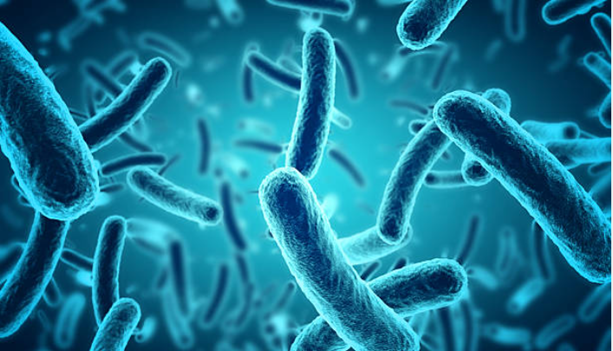
Secondary Metabolites of Bacteria
Submitted by:
Shreeram Kumar singh (mt23091)

Slide 2
Task 1 : Secondary Metabolites of Bacteria Pubmed
Analyzing the production of secondary metabolites in bacteria involves compiling a list of bacteria known for producing these compounds, retrieving their metabolic data, and delving into literature to understand their biosynthesis pathways. By identifying correlations and common factors within the metabolic datasets of these bacteria, researchers aim to uncover the molecular mechanisms driving secondary metabolite production. Examining secondary metabolite production in bacteria entails compiling a roster of relevant bacterial species and accessing their metabolic data. Researchers delve into literature to unravel biosynthesis strategies, seeking correlations and commonalities across the metabolic datasets of these bacteria.

Slide 3
Task 2 : Collecting Available Databases
For the study on secondary metabolites of bacteria, data gathering was systematically conducted via thorough searches on PubMed and Europe PMC, ensuring comprehensive dataset acquisition. The approach involved extracting pertinent details from scholarly literature, adhering to professional standards in scientific inquiry. By utilizing these reputable databases, a diverse and robust dataset was assembled, enabling a comprehensive exploration of bacterial secondary metabolites. This meticulous process facilitated the acquisition of high-quality data, supporting rigorous analysis and interpretation in scientific exploration.

Slide 4
TASK 3 : Run Pubmed.miner over all the papers
Following abstract retrieval, I use the Pubtator function to extract genes, diseases, mutations, chemicals, and species relevant to bacterial secondary metabolites. To ensure data accuracy, I merge duplicate entries based on identical chemical, gene, disease, and species attributes. Subsequently, I consolidate corresponding PubMed IDs using a grouping method, simplifying data presentation while maintaining the consistency and thoroughness essential for studying bacterial secondary metabolites.

Slide 5
TASK 4 : GiveSentences()
Upon obtaining abstracts, I use the Pubtator tool to extract genes, diseases, mutations, chemicals, and species pertinent to bacterial secondary metabolites. To ensure data reliability, I merge duplicate entries based on identical chemical, gene, disease, and species attributes. Subsequently, I combine associated PubMed IDs through grouping, simplifying data organization while maintaining the consistency and comprehensiveness crucial for studying bacterial secondary metabolites.

Slide 6
TASK 5 : Available Databases
Compilation of a CSV file containing information on 4 databases. Each entry includes details such as the database link, publication link, publication year, and a brief description. I generated this file after conducting a search using the keywords "Secondary Metabolites Bacteria."

Slide 7
TASK 6 : Proteins (UNIPROT)
Exploring the genes and proteins related to this topic using information from UniProt has given me a better understanding of their roles in the biosynthesis, regulation, and function of secondary metabolites in bacteria. This insight helps us delve deeper into the molecular mechanisms and potential applications of these compounds.

Slide 8
TASK 7 : Geodata
Compiling comprehensive data on the occurrence and geographical distribution of bacteria producing secondary metabolites across diverse regions and historical timeframes is paramount. This dataset offers invaluable insights into not only the presence and abundance of these bacteria but also the dynamics of their metabolite production and evolution over time. By analyzing this rich reservoir of information, researchers can uncover patterns and trends essential for understanding the intricate interplay between these bacteria and their secondary metabolite production.

Slide 9
TASK 8 : Responsible Protein
The collected data comprises proteins and genes essential for the production of secondary metabolites in bacteria, encompassing adaptations that enable efficient biosynthesis of these compounds. This includes molecular mechanisms facilitating the regulation and production of secondary metabolites, shedding light on the biological strategies employed by bacteria to produce and utilize these compounds in various environments.

Slide 10
TASK 9 : Chemical Drug
I've assembled data on chemicals and pharmaceutical compounds, including their names, IDs, references, and clinical trial stages, along with other pertinent details. This dataset covers a wide array of pharmaceutical compounds and their associated information.

Slide 11
TASK 10 : Chemical-Gene Interaction
I have implemented a data processing script that merges datasets on bacterial secondary metabolites, analyzes sentence embeddings with the Universal Sentence Encoder, and extracts interaction types and regulatory patterns, ultimately saving the refined DataFrame as a CSV file. FILE SUBMITTED:
1>TASK_10_Gene_Gene_OUTPUT.csv
2>TASK_10_Gene_Chemical_OUTPUT.csv
3>TASK_10_Chemical_Chemical_OUTPUT.csv
4>TASK_10_Chemical_Disease_OUTPUT.csv

Slide 12
Task-11 : Pathways Extraction Process
Retrieved KEGG pathways and saved them as "kegg_pathways.txt".
Employed a Jupyter Notebook script to perform text mining, extracting pathways from full-text papers without PMC IDs by referencing "kegg_pathways.txt".
Compiled the findings into a summary DataFrame with PMIDs and pathway matches, and created "Final_Pathways.csv" to consolidate identified pathways and their associated PMIDs for further research.

Slide 13
Task-12: Verification of Secondary Metabolites of bacteria-related Sentences Using BioBert
CSV File Specification: Used CSV files from Task 4 for validating sentences.
Model Setup and Execution: Developed Python scripts for verification and configured the BIOBERT model and tokenizer.

Slide 14
Verification Process:
Assessed sentences using BIOBERT with a set threshold, categorizing them as True (relevant) or False (not relevant).
Output Handling:
Recorded results in an output CSV file, including the original sentences along with their verification status.

Slide 15
Task-13 : Summary Of Sentences
BERT Summarizer Implementation:
Used BERT Summarizer for abstractive text summarization.
Capabilities Exploration:
Evaluated its ability to condense text while maintaining coherence.
Summarization Execution:
Tested the model for summary clarity and informativeness.
Performance Assessment:
Measured how well it captures key points and the essence of the text.

Slide 16
Task-14 : Protein Information And Analysis
Retrieval and Processing of UniProt Data:
Constructed API queries
Downloaded data
Extracted and compiled information

Slide 17
Retrieving Protein Structures from the RCSB Protein Data Bank (PDB)
Sending Requests to the RCSB Search API
Formulate search queries
Dispatch requests
Save responses
Extracting Identifiers
Parse the responses
Compile the complete list

Slide 18
Fetching Detailed Data
1.Construct URLs
2. Send Requests
3.Extract Information
Data Storage And Retrieval
1.Contructing Urls for Data Fetching
2.Fetching And Parsing Json Responses
3.Storing and Reporting:
a> Store Data
b>Handle Errors
c> Mantaing Logs

Slide 19
Task-15 : Knowledge - Graph
Objective: To visualize and analyze chemical-gene interactions using an interactive graph tool.
Data Acquisition and Preprocessing:
Collect and prepare data.
Graph Construction:
Create the graph structure.
Node and Edge Representation:
Define nodes and edges.

Slide 20
Streamlit App Configuration:
Set up the visualization app.
Interactive Graph Visualization:
Display the interactive graph.
Future Development Potential:
Identify opportunities for further development.
User Feedback Integration:
Incorporate feedback for improvements.
Scalability Planning:
Plan for expanding the graph's capabilities.

Slide 21
Task-16 : Graph Interaction
Gene To Chemical -
Implementation Steps:-
Chemical Association
Visualization (via Graph)
Chemical Contextual Information

Slide 22
Gene To Disease -
Implementation Steps:-
Disease Association
Visualization
Contextual Information
Gene To Gene-
Implementation Steps:-
Data Extraction
Edge Representation
Pathways Analysis

Slide 23
Task-17 : Biological Knowledge Graph
Objective: Created a biological knowledge graph to visualize interactions among genes, chemicals, diseases, and species, aiding in understanding complex biological relationships.
Data Source: Utilized data from the CSV file "Task1_pubmed_secondary_metabolites_Bacteria.csv," covering genes, chemicals, diseases, and species.

Slide 24
Graph Construction: Built a directed graph using NetworkX, adding nodes for each unique entity and edges to represent relationships like gene-disease associations and chemical-gene interactions.
Subgraph Selection: Focused on the top 200 nodes based on degree centrality to highlight the most influential entities and simplify the graph's complexity.
Visualization and Output: Used spring layout for node positioning and Plotly for interactive visualization, saved as "biological_knowledge_graph_200_resized.html" for easy exploration

Slide 25
Thank you

